Slide 1
Decision Tree Modeling in R
DARTH workgroup

Slide 2
Decision Tree (a type of model)
Schematic representation of all of the important outcomes of a decision (e.g., clinical, economic, non-health sectors)
Used to combine knowledge about decision problem from many sources
Computes average outcomes (e.g., costs, events, QALYs) from decisions
Notes:
So let’s start with: “what is a decision tree”
A decision tree is a decision support tool that gives a schematic representation of all the important possible consequences of a decision.
We can use this decision tree tool combine knowledge about the decision problem from many sources. For example, the treatment effect comes from a clinical trial, while the age specific mortality comes from national observation studies.
And for comparisons of the decision, the tree computes the average outcomes

Slide 3
Components of a decision tree
The alternative strategies of a decision making process
The events that follow from application of any of these strategies and their likelihood
The outcomes (for an individual, a cohort or a population)
Notes:
In general every decision tree has be split in three components.
Firstt we start with the alternative strategies or alternative decision we are considering.
Second the event that follow from selecting a strategy and the likelihood of these evenst under the cersomstances of slecting this strategy
And third and last the outcomes related to the sequence of events.

Slide 4
Structure of a decision tree
A tree consists of 3 different types of nodes connected via branches:
A decision tree starts with a decision node, which represents the choices a decision maker has between mutually exclusive strategies
A chance node represents possible events that could occur following a decision or a previous event. We include probabilities of these events in the tree.
A terminal node represents end points of each complete branch and the outcome associated with it.

Slide 5
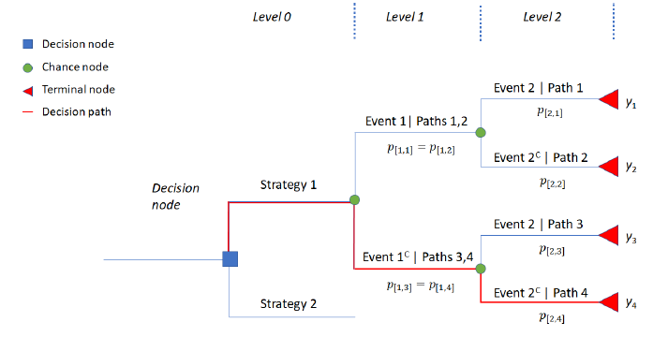
Plot of a sample decision tree
Event 2
Event 1
Not Event 2
Event 2
Not Event 1
Not Event 2
Compute average outcomes: a “folding back” method

Slide 6
Simple Decision Tree
Viral encephalitis can be caused by herpes virus (HVE) or other viruses (OVE); Pr(HVE) = 52%.
Untreated HVE leads to severe sequelae in 71%; for OVE this is 1%.
A drug, vidarabine, decreases severe sequelae due to HVE from 71% down to 36%.
Side effects cause an increase in severe sequalae among OVE patients treated with vidarabine from 1% to 20%.

Slide 7
Draw the tree

Slide 8
To treat or not to treat
HVE
0.36
0.52
Treat
0.48
OVE
0.20
HVE
0.71
0.52
Do not treat
0.48
OVE
0.01
Outcome = Pr(severe sequelae)

Slide 9
0.52*0.36 + 0.48*0.20 = 0.2832
0.36
HVE
0.52
Treat
0.48
OVE
0.20
HVE
0.71
0.52
Do not treat
0.48
OVE
0.01

Slide 10
0.52*0.36 + 0.48*0.20 = 0.2832
HVE
0.36
0.52
Treat
0.48
OVE
0.20
HVE
0.71
0.52
Do not treat
0.48
OVE
0.01
0.52*0.71 + 0.48*0.01 = 0.3740

Slide 11
There is a third option
It is possible to obtain a definitive diagnosis by means of brain biopsy, but this procedure itself carries a risk of mortality of 0.5%.
Outcome = Pr(severe sequelae and/or dead)

Slide 12
Draw the tree

Slide 13
0.2832
HVE
0.36
0.52
Treat
0.48
OVE
0.20
0.3740
HVE
0.71
Do not treat
0.52
0.48
OVE
0.01
Biopsy

Slide 14
0.2832
HVE
0.36
0.52
Treat
0.48
OVE
0.20
0.3740
HVE
0.71
Do not treat
0.52
0.48
OVE
0.01
Survive
Biopsy
0.995
0.005
Biopsy death

Slide 15
0.2832
HVE
0.36
0.52
Treat
0.48
OVE
0.20
0.3740
HVE
0.71
Do not treat
0.52
0.48
OVE
0.01
HVE
0.36
Survive
0.52
Biopsy
0.995
0.48
OVE
0.01
0.005
Biopsy death
1.00

Slide 16
0.2832
HVE
0.36
0.52
Treat
0.48
OVE
0.20
0.3740
HVE
0.71
Do not treat
0.52
0.48
OVE
0.01
0.1920
HVE
0.36
Survive
0.52
Biopsy
0.995
0.48
OVE
0.01
0.005
Biopsy death
1.00

Slide 17
0.2832
HVE
0.36
0.52
Treat
0.48
OVE
0.20
0.3740
HVE
0.71
0.52
Do not treat
0.48
OVE
0.01
0.1920
0.1960
HVE
0.36
Survive
0.52
Biopsy
0.995
0.48
OVE
0.01
0.005
Biopsy death
1.00

Slide 18
Estimating decision tree outcomes in R
Notes:
Eline

Slide 19
Compute average outcomes
The (average) expected value of the outcomes (i.e. cost, QALYs) of a strategy in a decision tree can be calculated by using the below steps:
Identify all branches in this strategy
Multiply all conditional probabilities in a branch
The product of all conditional probabilities is then multiplied with the outcome value of that branch
Repeat steps 2 and 3 for each branch
Sum (the product of conditional probabilities x outcome) for all branches under this strategy

Slide 20
Plot of a sample decision tree

Slide 21
0.995*0.52 = 0.5174
HVE
0.36
Survive
0.52
Biopsy
0.995
0.48
OVE
0.01
0.005
Biopsy death
1.00
0.995*0.48 = 0.4776

Slide 22
0.5174*0.36 + 0.4776 *0.01 = 0.1910
0.5174
HVE
0.36
Survive
0.52
Biopsy
0.995
0.48
OVE
0.01
0.005
Biopsy death
1.00
0.4776
0.1910 + 0.0050 =0.1960
0.005

Slide 23
Compute average outcomes – in R
The steps to calculate expected outcome(s) could be done easily in R in the following way:
Store the product of all conditional probabilities of each branch in a vector
Store the associating outcomes in a vector
Take the product of the two vectors using matrix multiplication.

Slide 24
R Session
Notes:
Part 1 = Showing code 3 state model
Part 2 = Exercise build Sick-Sicker model
Part 3 = Show answers of Sick-Sicker

